Slide 1

Automated Weekly Sales & Subscription Report (n8n Capstone Project)
Presented by: Peace Adamu
Link to Github Readme: https://github.com/peace-adamu/Ziti-Academy---Capstone-Project
📘 Project Overview
This project automates the process of collecting, analyzing, and reporting weekly business KPIs from multiple data sources using n8n. It eliminates manual work and delivers actionable insights via email and Slack every Monday at 8 AM.

Slide 2
⚙️ Workflow Summary
1️⃣ Sales & Subscription Report Workflow
Trigger: Every Monday at 8 AM
Processes:
Sales Data Node:
Sales Functiosn Node:
Fetches sales records from Google Sheets.
Calculate:
Total Revenue
Total Units Sold
Top Product
Top Region
Subscription Data Node:
Subscription Function Node:
Fetches customer subscription data.
Calculates:
Subscription Revenue
Active Customers
Canceled Customers
Top Subscription Type
Merge Node:
Email Node (Gmail):
Combines both datasets.
Sends HTML-formatted report to stakeholders.
Slack Node:
Google Sheets Log:
Posts summary to the Slack workspace.
Archives weekly metrics for history tracking.
📅 Trigger: Cron node runs automatically every week.

Slide 3






2️⃣ Error Handler Workflow
Ensures the main automation never fails silently. When an error occurs, this secondary workflow runs automatically to:
Send a Slack alert
Email the error details
Log the issue in Google Sheets

Slide 4
Data Flow Diagram
[Trigger (Schedule)]
│
├──► [Sales Data] ─► [Compute Sales KPIs]
│
└──► [Customer Data] ─► [Compute Subscription KPIs]
│
▼
[Merge Node]
│
▼
[Message Compute KPI]
│
┌──────────────────┼──────────────────┐
▼ ▼ ▼
[Send Email] [Send Slack] [Weekly Report Log]

Slide 5
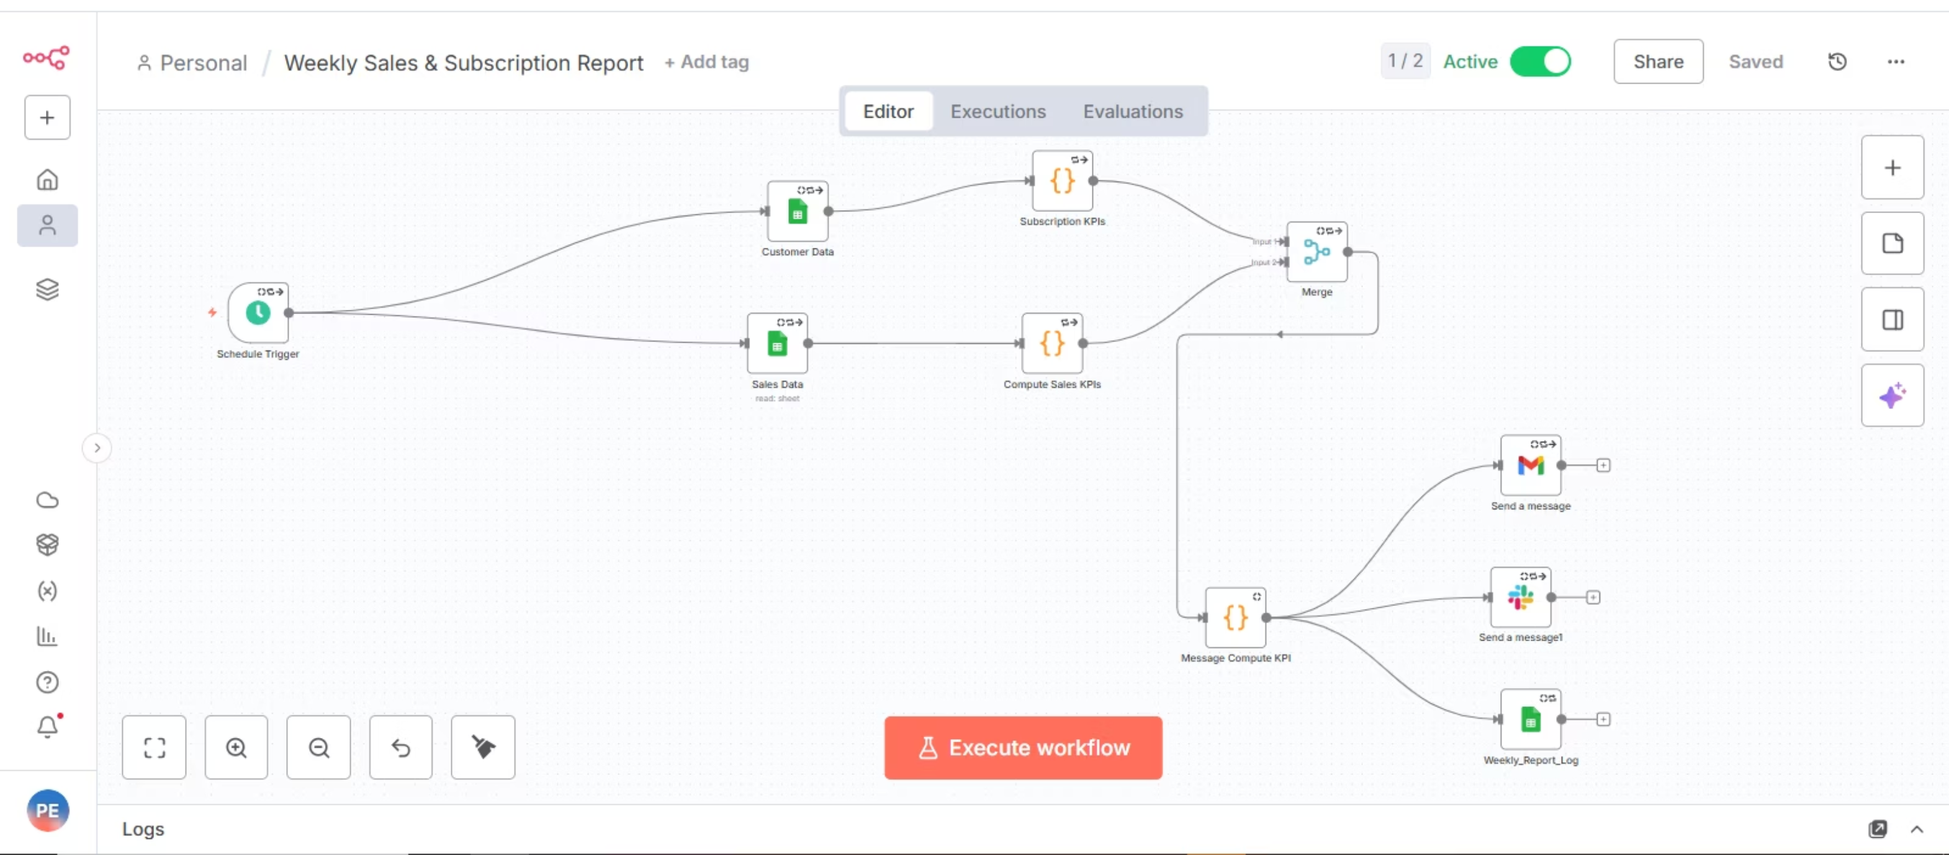

Slide 6
📊 KPIs Generated
🛍️ Sales KPIs
💳 Subscription KPIs
Metric
Description
Metric
Description
Total Revenue
Quantity × UnitPrice
Total Subscription Revenue
Sum of subscription income
Total Units Sold
Total sales volume
Active Customers
Count of ongoing subscriptions
Top Product
Best-performing product
Top Region
Highest revenue region
Canceled Customers
Count of terminated subscriptions
Top Subscription Type
Most subscribed plan

Slide 7
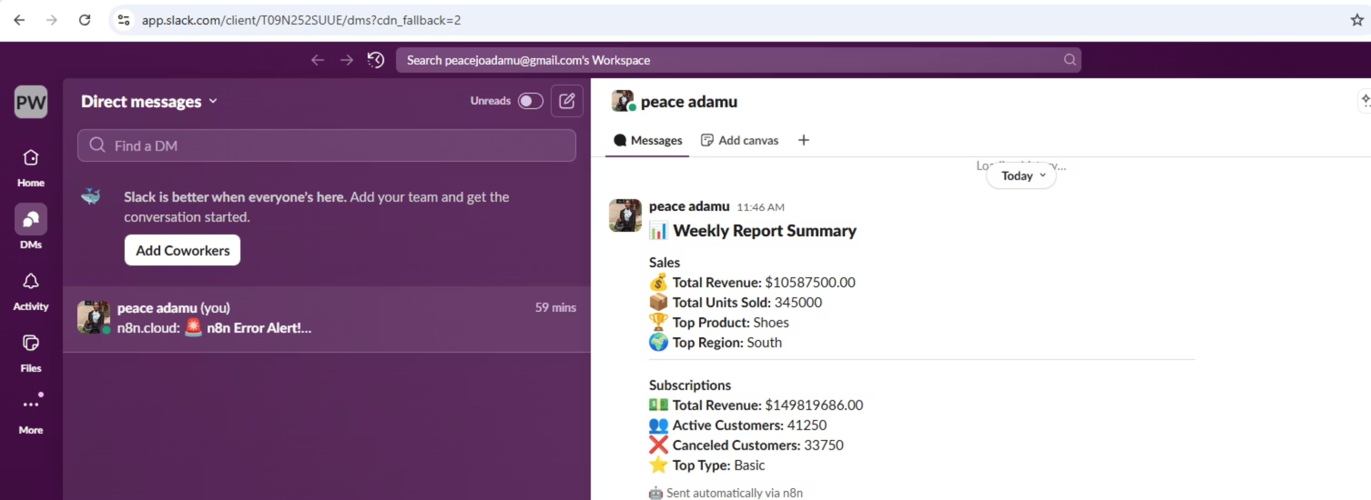
📧 Email Report Template (HTML)
📊 Weekly Sales & Subscription Report
Hello Team,
Here’s the automated summary for this week:
Sales KPIs & Subscription KPIs
Example Slack Output
Example Email Output:Best regards, n8n Automation Bot 🤖
📸

Slide 8
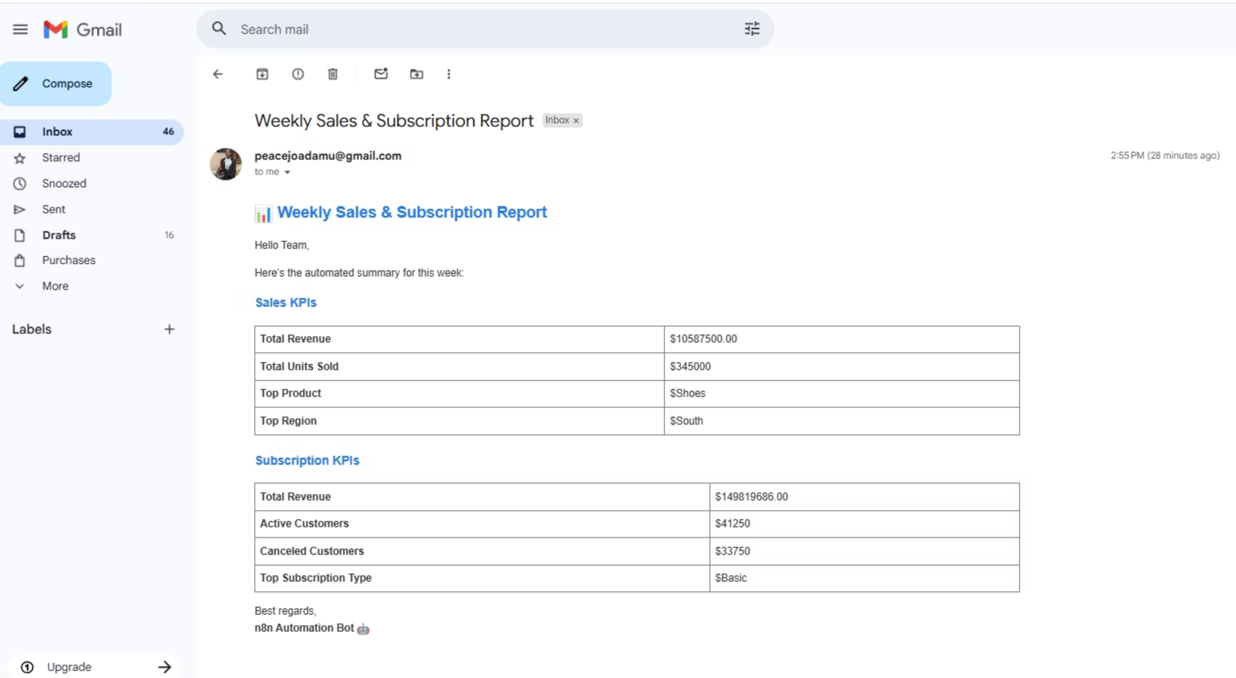
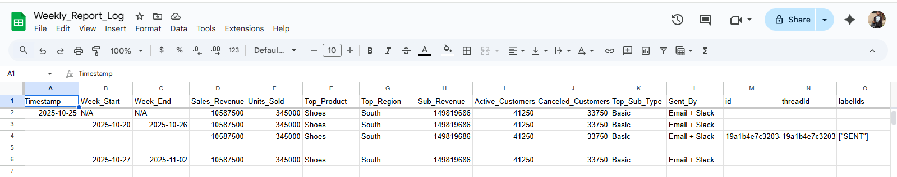

Slide 9
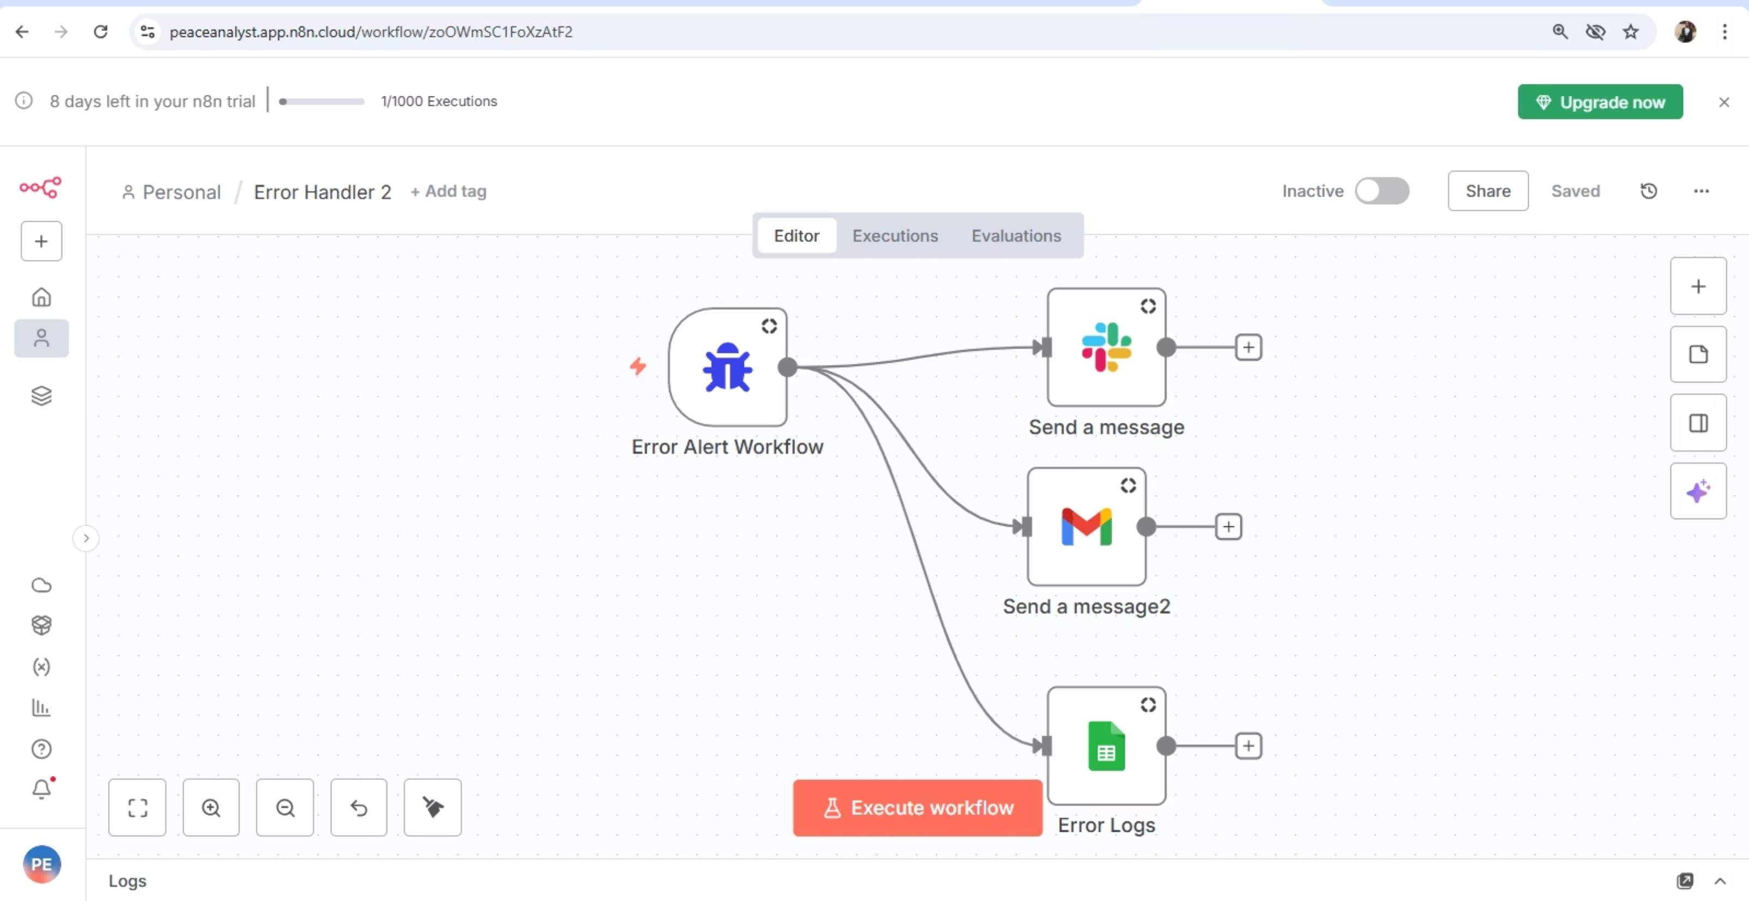
⚠️ Error Handling & Automation Design
Component
Purpose
Error Trigger Workflow
Detects failed execution
Slack Node
Sends alert to development channel
Gmail Node
Sends detailed error report
Google Sheets Log
Stores error details for audit
IF & Try/Catch Nodes
Ensures safe execution even when data is missing

Slide 10
🧰 Technical Stack
Tool:
n8n
Logic:
JavaScript (Function Nodes)
Data Sources:
Google Sheets (Sales & Subscription tables)
Output:
Automated HTML Email Report + Slack Summary
Error Logs:
Google Sheets
Integrations:
Gmail | Slack | Google Sheets

Slide 11
📈 Example Weekly Output
$10.5M
345K
41,250
33,750
Sales Revenue
Units Sold
Active Customers
Canceled Customers
$149.8M
Subscription Revenue
Top Product: Shoes
Top Region: South
Top Subscription Type: Basic

Slide 12
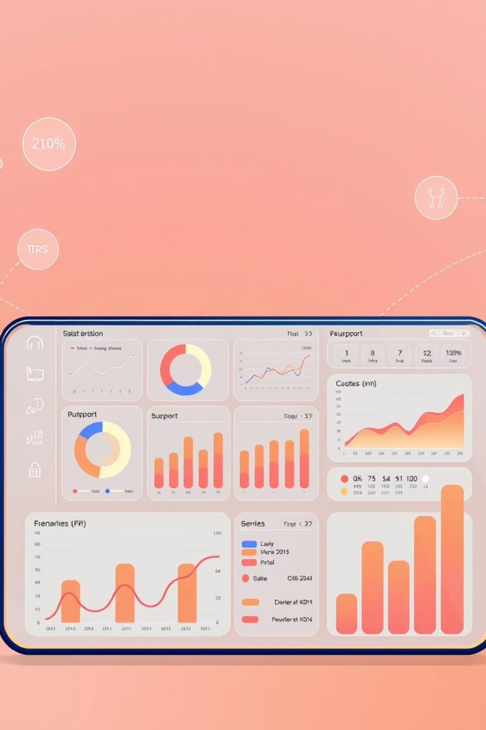

🌱 Future Enhancements
Add visual charts in the email using HTML/CSS
Send Slack or Discord alerts for delivery confirmations.
Integrate marketing/support KPIs for a unified business dashboard.

